Slide 1



SETHU INSTITUE OF TECHNOLOGY
An Autonomous Institution | Affiliated to Anna University, Chennai
Pulloor, Kariapatti – Virudhunagar 626 115
Department of
Computer Science and Business Systems
FIRST REVIEW
E – BOT
An Advanced Deep Learning based Chatbot built using NLP and Keras Neural Networking
Batch Members
Aravind S – 2020113002
Aravinth S – 2020113003
Palaniappan M – 2020113306
Guided By
Stalin J
Assistant Professor
Sethu Institute of Technology

Slide 2


Abstract
Web based Chatbot for easier access.
Allows both user to navigate through Tamilnadu E-Service websites.
Adapts to the users prompt and gives respective answers.
Records the users prompt to train the chatbot.

Slide 3
Literature Survey
Title of Paper | Description | Publications Details
A Survey Paper on Chatbots | This paper aims at providing some positive information through continuous dialogue answers in order to guide adolescents to think and face difficulties with a positive and optimistic attitude and the agenda of reliving the psychological pressure of the adolescents can be achieved. | Aafiya Shaikh, Dipti More Pimpri Chinchwad College of Engineering IRJET Volume: 06 Issue: 04 | Apr 2019
Chatbots in Customer Service: Relevance and Impact. | opportunities to improve customer service. The present paper examines chatbots in this context, elaborating on their functional aspects that are rapidly leading to significant improvements in service quality. First, based on a literature review of recent publications in this field, an overview of their key features and functionalities. | Chiara Valentina Misischia University of Vienna Science Direct Volume 11 | March 22-25, 2022

Slide 4
Literature Survey
Title of Paper | Description | Publications Details
Design and Development of CHATBOT: A Review | This paper focuses on a newly emerging tool for learning from CHATBOT, which is a learning-cum-assisted tool. A CHATBOT is an artificially created virtual entity that interacts with users using interactive textual or speech skills. | Rohit Tamrakar, Niraj Wani Sardar Vallabhabhi National Institute Research Gate Volume: 16 Issue: 12 - Apr 2021
Rule Based Chatbot | Chatterbots engage in a conversation with the client and respond to the client based on human input. It gives the impression that the user is conversing with a human when they was having a conversation with humans or with a computer. | Parsi Anurag The School Of Computer Science And Engineering IRJETS Volume 04 | May 2022 | Issues: 05

Slide 5
Block Diagram
User Interface
ALGORIMTHS
Database
Sorting
API
Searching
Server
Finalization

Slide 6
Existing Solution
There is no prior feature to navigate users through websites.
Manual Navigation using human knowledge.
Existing chatbot available in the markets are.
Response Chatbot: Customer service chatbots
Rule – Based Chatbot: If – Else condition chatbot

Slide 7
Proposed System
The proposed systems is a Conventional Chatbot.
This chatbot guides users through E-Service websites.
Allows users to fetch details of places and officials.
Payment of bills like Electricity bill, Water bill, Etc.., [*optional]
Uses users chat to make suggestions.

Slide 8
Methodology
Scope and Objective
The scope of the chatbot is help users navigate through Tamilnadu E – Service websites
User – Centric Design
This Chatbot focuses on user’s comfort with features like translation to native languages and adaptive colors and auto complete for elderly people

Slide 9
Methodology
Data Collection
Collect various source of dataset for pre-processing at the initial stage of application.
Development and Testing
Usage of AGLIE methodology to build, test and maintain application in iterative process.

Slide 10
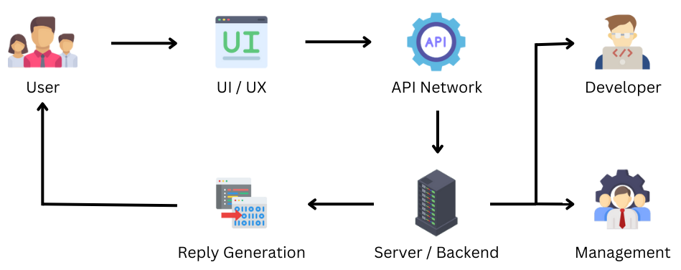
Work Flow

Slide 11
Algorithm
Natural Language Processing : Can understand and reply human like answers.
Tensor Flow : Used along with NLP to Implement Machine learning application.
Training Application – Used to train the chatbot using pre – processed dataset.
Real time generation – Used to learn from the user’s prompt.

Slide 12
Algorithm
KERAS Neural Network
It is a functionality available in TensorFlow package.
Builds a neural network between the queries, answers and keywords.
It is used to Fine tune the reply.
Stronger the neural connection, better the answer.

Slide 13





Hardware Requirements
CPU
4 core | 8 Thread
TPU
2 GB HBM | 6 Teraflops
RAM
6 GB (Minimum)
Connectivity
High – Speed Internet
Physical Storage
512 GB (Minimum)

Slide 14





Software Requirements
IDE
Visual Studio Code
Database
MySQL - Work Bench
Programming Language
Python 3.11.7
Designing Tool
Figma
Cloud Platform
Heroku

Slide 15
Expected Outcome
Assist users to navigate through website.
Simple User Interface to be understandable by all users.
Adaptable to users prompt even with mistakes.
Can be used in any application.
Data collected can be used to train in future.

Slide 16
Conference / Journal Publication
S No | Process | Progress
01 | Data Collection | Yet to Complete
02 | Report Creation | Yet to Complete
03 | Report Correction | Yet to Complete
04 | Journal Submission | Yet to Complete
05 | Journal Verification | Yet to Complete
06 | Journal Publication | Yet to Complete

Slide 17
Thank You

